Slide 1

Parking Application
TEAM 8

Slide 2

Introduce Our Team
Team 8
2301969931 - INDRA KURNIAWAN
2301970391 - PIO ANDINA
2301970290 - AMELIA AGATHA
2301968430 - IVAN DWI
2301969925 - DONY AFRIZAL

Slide 3


Job description
INDRA KURNIAWAN
Design and Coding
PIO ANDINA
Documentation and Tester
AMELIA AGATHA
Description of each job
Tester
IVAN DWI
Support
DONY AFRIZAL
Support

Slide 4
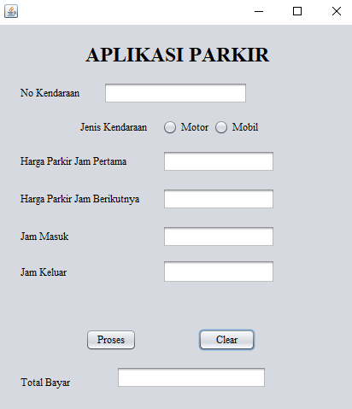
Features in the Parking app
Fitur Perhitungan Parkir Mobil
Parkir Jam Pertama = Rp 5000
Parkir Jam berikutnya = Rp 2000
Fitur Perhitungan Parkir Motor
Parkir Jam Pertama = Rp 2000
Parkir Jam Berikutnya = Rp 1000
NB:
Pembulatan round up per jam
< 1 jam di hitung 1 jam

Slide 5
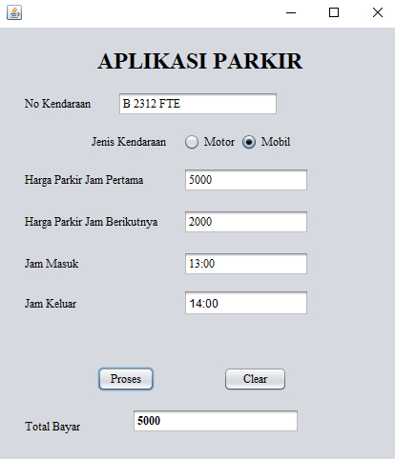
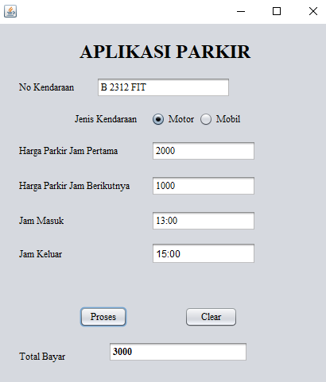
Parking Application
1
2a
2b
1 jam
2 jam
Total yang dibayar
Total yang dibayar
User Interface adalah GUI

Slide 6
Demo Parking Application

Slide 7
THANK YOU!
Team 8

